Slide 1

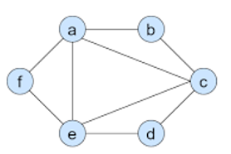
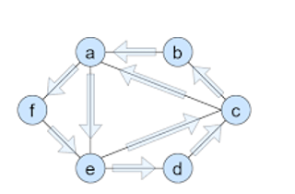

Slide 2
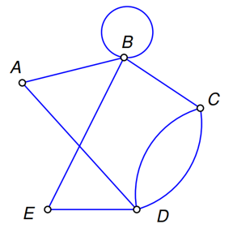
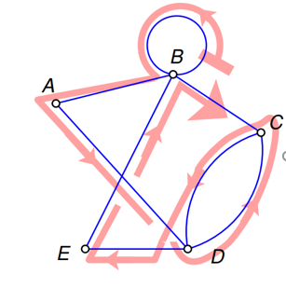


Slide 3
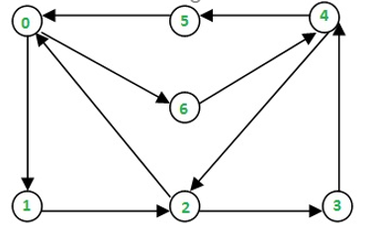
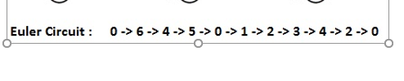

Slide 4
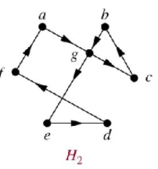


Slide 5
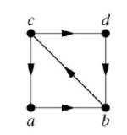


Slide 6
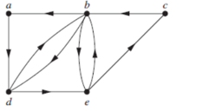
a, d, b,d, e,b,e, c,b,a

Slide 7




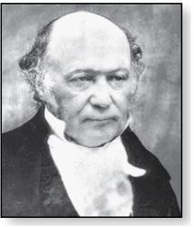
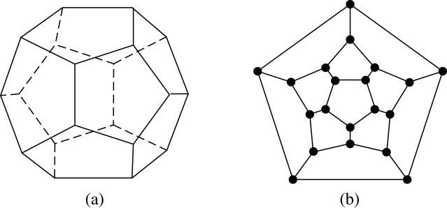
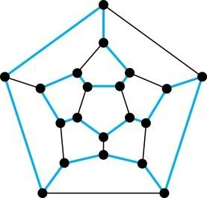
Hamilton Paths and Circuits
William Rowan Hamilton (1805- 1865)
Euler paths and circuits contained every edge only once.
Now we look at paths and circuits that contain every vertex exactly once.
William Hamilton invented the Icosian puzzle in 1857. It consisted of a wooden dodecahedron (with 12 regular pentagons as faces), illustrated in (a), with a peg at each vertex, labeled with the names of different cities. String was used to used to plot a circuit visiting 20 cities exactly once
The graph form of the puzzle is given in (b).
The solution (a Hamilton circuit) is given here.

Slide 8

Hamilton Paths and Circuits
Definition: A simple path in a graph G that passes through every vertex exactly once is called a Hamilton path, and a simple circuit in a graph G that passes through every vertex exactly once is called a Hamilton circuit.
That is, a simple path x₀, x₁, …, x_{n-1}, x_{n} in the graph G = (V,
E) is called a Hamilton path if V = {x₀, x₁, … , x_{n-1,} x_{n} } and x_{i}
≠ x_{j} for 0≤ i < j ≤ n, and the simple circuit x₀, x₁, …, x_{n-1}, x_{n}, (with n > 0) is a Hamilton circuit if x₀, x₁, … , x_{n-}
x₀
₁, x_{n} is a Hamilton path.

Slide 9
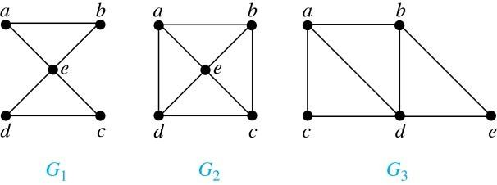
Hamilton Paths and Circuits
Example: Which of these simple graphs has a Hamilton circuit or, if not, a Hamilton path?
Solution:
G₁ does not have a Hamilton circuit (Why?), but does have a Hamilton path : a, b ,e , c, d.
G₂ has a Hamilton circuit: a, b, c, d, e, a. G₃ has a Hamilton circuit: a,b,e,d,c,a

Slide 10



Necessary Conditions for Hamilton Circuits
Gabriel Andrew Dirac (1925-1984)
Unlike for an Euler circuit, no simple necessary and sufficient conditions are known for the existence of a Hamiton circuit.
However, there are some useful sufficient conditions. We describe two of these now.
Dirac’s Theorem: If G is a simple graph with n ≥ 3 vertices such that the degree of every vertex in G is ≥ n/2, then G has a Hamilton circuit.
Ore’s Theorem: If G is a simple graph with n ≥ 3 vertices such that deg(u) + deg(v) ≥ n for every pair of nonadjacent vertices, then G has a Hamilton circuit.
Øysten Ore
(1899-1968)

Slide 11

Applications of Hamilton Paths and Circuits
Applications that ask for a path or a circuit that visits each intersection of a city, each place pipelines intersect in a utility grid, or each node in a communications network exactly once, can be solved by finding a Hamilton path in the appropriate graph.
The famous traveling salesperson problem (TSP) asks for the shortest route a traveling salesperson should take to visit a set of cities. This problem reduces to finding a Hamilton circuit such that the total sum of the weights of its edges is as small as possible.
A family of binary codes, known as Gray codes, which minimize the effect of transmission errors, correspond to Hamilton circuits in the n-cube Q_{n.}

Slide 12
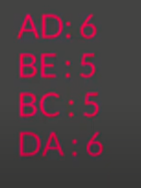
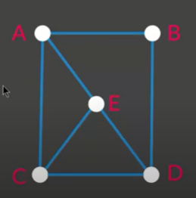
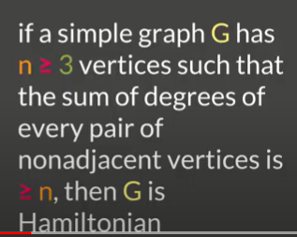
Ore’s Theorem

Slide 13
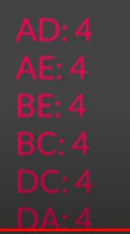
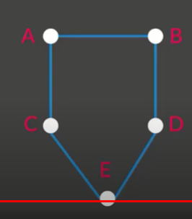
Ore’s Theorem

Slide 14
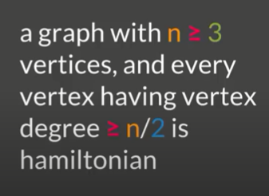
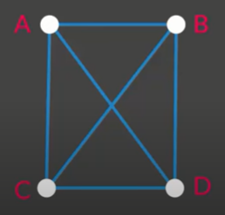
Direc’s Theorem
Deg(A) = 3
Deg(B) = 3
Deg(C) = 3
Deg(D) = 3

Slide 15
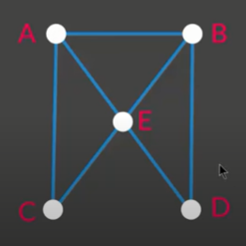
Direc’s Theorem
Deg(A) = 3
Deg(B) = 3
Deg(C) = 2
Deg(D) = 2

Slide 16
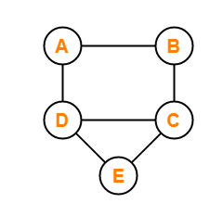


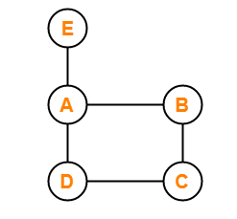


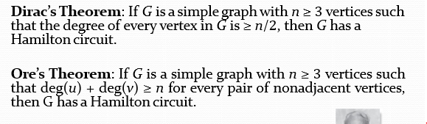

Slide 17
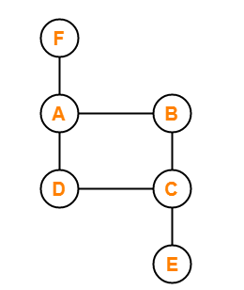


Slide 18
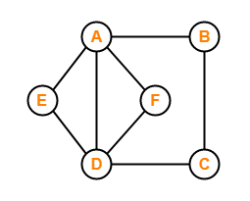
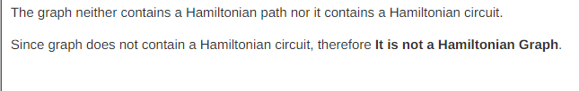
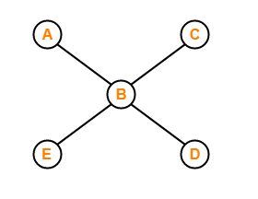
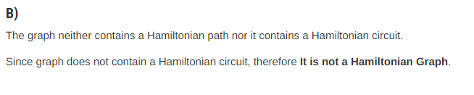

Slide 19
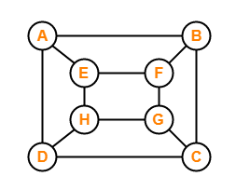
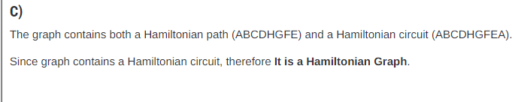
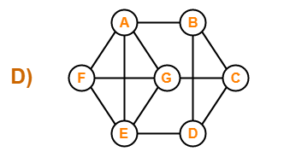
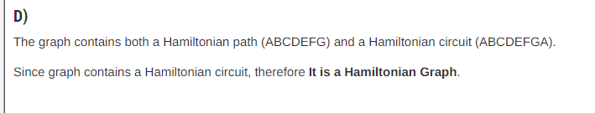

Slide 20
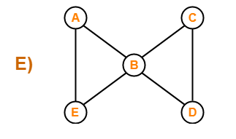
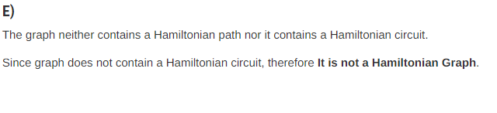
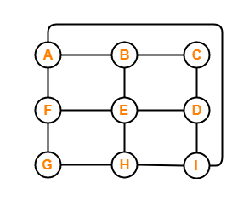
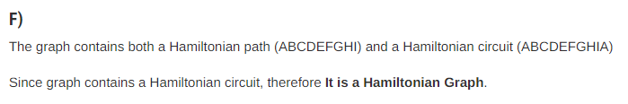

Slide 21


Section 10.3

Slide 22
Isomorphism in Graphs: You guys studied isomorphism in chemistry, you need just recall the isomorphism here. The chemical compounds having same molecular formula but they have different structures, so this isomorphism concept is also found in graphs. That is same number of vertices and edges and different structures.

Slide 23
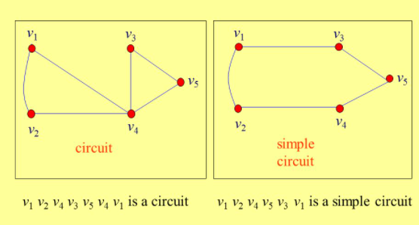

Slide 24

Isomorphism of Graphs
Definition: The simple graphs G₁ = (V₁, E₁) and
G₂ = (V₂, E₂) are isomorphic if there is a one-to-one function f from V₁ to V₂ with the property that a and b are adjacent in G₁ if and only if f(a) and f(b) are adjacent in G₂ , for all a and b in V₁ . Such a function f is called an isomorphism. Two simple graphs that are not isomorphic are called nonisomorphic.

Slide 25
Isomorphism of Graphs
It is difficult to determine whether two simple graphs are isomorphic using brute force because there are n! possible one-to-one correspondences between the vertex sets of two simple graphs with n vertices.
The best algorithms for determining weather two graphs are isomorphic have exponential worst case complexity in terms of the number of vertices of the graphs.
Sometimes it is not hard to show that two graphs are not isomorphic. We can do so by finding a property, preserved by isomorphism, that only one of the two graphs has. Such a property is called graph invariant.
There are many different useful graph invariants that can be used to distinguish nonisomorphic graphs, such as the number of vertices, number of edges, and degree sequence (list of the degrees of the vertices in nonincreasing order). We will encounter others in later sections of this chapter.

Slide 26
ISOMORPHIC INVARIANT
A property P is called an isomorphic invariant if, and only if, given any graphs G and G’,
If G has property P and G’ is isomorphic to G, then G’ has property P.
THEOREM OF ISOMORPHIC INVARIANT
Each of the following properties is an invariant for graph isomorphism,
where n, m and k are all non-negative integers, if the graph:
has n vertices.
has m edges.
has a vertex of degree k.
has m vertices of degree k.
has a circuit of length k.
has a simple circuit of length k.
has m simple circuits of length k.
is connected.
has an Euler circuit.
has a Hamiltonian circuit.

Slide 27
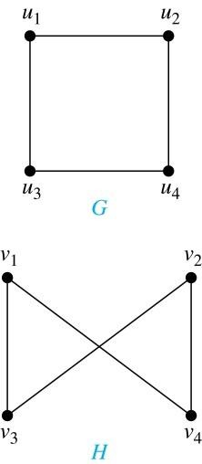
Isomorphism of Graphs (cont.)
Example: Show that the graphs G =(V, E) and
H = (W, F) are isomorphic.
Solution: The function f with
f(u₁) = v₁,f(u₂) = v₄, f(u₃) = v₃, and f(u₄) = v₂
correspondence between V and W. Note that adjacent vertices in G are u₁ and u₂, u₁ and u₃, u₂ and u₄, and u₃ and u₄. Each of the pairs f(u₁) = v₁ and f(u₂) = v₄, f(u₁) = v₁ and f(u₃) = v₃ , f(u₂) = v₄ and
f(u₄) = v₂ , and f(u₃) = v₃ and
is a one-to-one
f(u₄) = v₂ consists of two adjacent vertices in H.

Slide 28

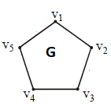
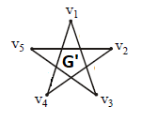
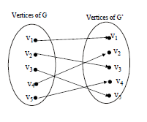
Isomorphism of Graphs
Example: Show that the graphs G =(V, E) and G’ = (W, F) are isomorphic.
Solution: The function f with
f(v1) = v1,f(v2) = v3, f(v3) = v5, f(v4) = v2 and f(v5) = v4 is a one-to-one correspondence between V and W.
Note that adjacent vertices in G are v1 and v2,
v2 and v3, v3 and v4, v4 and v5 and v5 and v1.
Each of the pairs f(v1) = v1 and f(v2) = v3, f(v2) = v3 and f(v3) = v5 , f(v3) = v5 and
f(v4) = v2 , f(v4) = v2 and f(v5) = v4 and f(v5)
= v4 and f(v1) = v1 consists of two adjacent vertices in H.

Slide 29

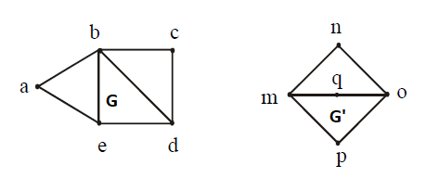
Isomorphism of Graphs
EXAMPLE: Determine whether the graph G and G’ given below
are isomorphic.
SOLUTION:
As both the graphs have the same number of vertices. But the graph G has 7 edges and the graph G’ has only 6 edges. Therefore the two graphs are not isomorphic.
Note: As the edges of both the graphs G and G’ are not same then how the one-one correspondence is possible ,that the reason the graphs G and G’ are not isomorphic.

Slide 30

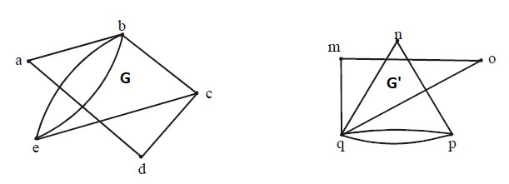
Isomorphism of Graphs
EXAMPLE: Determine whether the graph G and G’ given below are isomorphic.
SOLUTION:
Both the graphs have 5 vertices and 7 edges. The vertex q of G’ has degree 5. However G does not have any vertex of degree 5 (so one-one correspondence is not possible). Hence, the two graphs are not isomorphic.

Slide 31

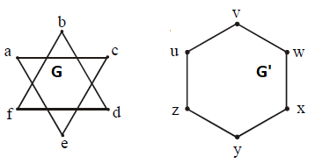
Isomorphism of Graphs
EXAMPLE: Determine whether the graph G and G’ given below
are isomorphic.
SOLUTION:
Clearly the vertices of both the graphs G and G’ have the same degree (i.e “2”) and having the same number of vertices and edges but isomorphism is not possible. As the graph G’ is a connected graph but the graph G is not connected due to have two components (eca and bdf ). Therefore the two graphs are non isomorphic.

Slide 32

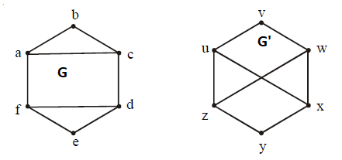
Isomorphism of Graphs
EXAMPLE: Determine whether the graph G and G’ given below
are isomorphic.
SOLUTION:
Clearly G has six vertices, G’ also has six vertices. And the graph G has two simple circuits of length 3; one is abca and the other is defd. But G’ does not have any simple circuit of length 3(as one simple circuit in G’ is uxwv of length 4).Therefore the two graphs are non-isomorphic.
Note: A simple circuit is a circuit that does not have any other repeated vertex except the first and last.

Slide 33
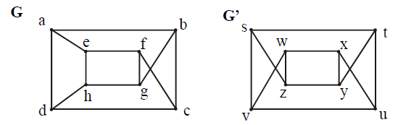
Isomorphism of Graphs
EXAMPLE: Determine whether the graph G and G’ given below are isomorphic.
SOLUTION:
Both the graph G and G’ have 8 vertices and 12 edges and both are also called regular graph(as each vertex has degree 3).The graph G has two simple circuits of length 5; abcfea(i.e starts and ends at a) and cdhgfc(i.e starts and ends at c). But G’ does not have any simple circuit of length 5 (it has simple circuit tyxut,vwxuv of length 4 etc). Therefore the two graphs are non-isomorphic.

Slide 34

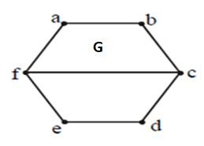
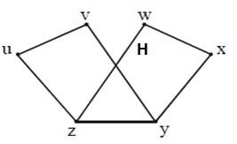
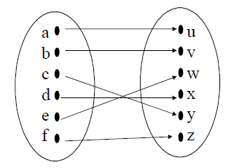
Isomorphism of Graphs
EXAMPLE: Determine whether the given graph G and H are isomorphic.
Solution:
Solution: The function f with
f(a) = u, f(b) = v, f(c) = y, f(d) = x, f(e) = w and f(f) = z is a one-to-one correspondence between G and H.
Note that adjacent vertices in G are a and b, b and c, c and d, c and f, d and e, e and f and f and a.
Each of the pairs f(a) = u and f(b) = v, f(b) = v and f(c) = y , f(c) = y and f(d) = x , f(c) = y and f(f) = z , f(d) = x and f(e) = w, f(e) = w and f(f)
= z and f(f) = z and f(a) = u consists of two adjacent vertices in H.

Slide 35



Isomorphism of Graphs (cont.)
Example: Determine whether these two graphs are isomorphic.
Solution: Both graphs have eight vertices and ten edges.
They also both have four vertices of degree two and four of degree three.
However, G and H are not isomorphic. Note that since deg(a) = 2 in G, a must correspond to t, u, x, or y in H, because these are the vertices of degree 2. But each of these vertices is adjacent to another vertex of degree two in H, which is not true for a in G.
Alternatively, note that the subgraphs of G and H made up of vertices of degree three and the edges connecting them must be isomorphic.
But the subgraphs, as shown at the right, are not isomorphic.

Slide 36

Isomorphism of Graphs
Example: Determine whether these two graphs are isomorphic.
Solution: Both graphs have six vertices and seven edges.
They also both have four vertices of degree two and two of degree three.
The subgraphs of G and H consisting of all the vertices of degree two and the edges connecting them are isomorphic. So, it is reasonable to try to find an isomorphism f.
We define an injection f from the vertices of G to the vertices of H that preserves the degree of vertices. We will determine whether it is an isomorphism.
The function f with f(u₁) = v₆, f(u₂) = v₃, f(u₃) = v₄, and f(u₄) = v₅ , f(u₅) = v₁, and f(u₆) = v₂ is a one-to-one correspondence between G and H. Showing that this correspondence preserves edges is straightforward, so we will omit the details here. Because f is an isomorphism, it follows that G and H are isomorphic graphs.

Slide 37

Algorithms for Graph Isomorphism
The best algorithms known for determining whether two graphs are isomorphic have exponential worst-case time complexity (in the number of vertices of the graphs).
However, there are algorithms with linear average-case time complexity.
You can use a public domain program called NAUTY to determine in less than a second whether two graphs with as many as 100 vertices are isomoprhic.
Graph isomorphism is a problem of special interest because it is one of a few NP problems not known to be either tractable or NP-complete (see Section 3.3).

Slide 38

Applications of Graph Isomorphism
The question whether graphs are isomorphic plays an important role in applications of graph theory. For example,
chemists use molecular graphs to model chemical compounds. Vertices represent atoms and edges represent chemical bonds. When a new compound is synthesized, a database of molecular graphs is checked to determine whether the graph representing the new compound is isomorphic to the graph of a compound that this already known.
Electronic circuits are modeled as graphs in which the vertices represent components and the edges represent connections between them. Graph isomorphism is the basis for
the verification that a particular layout of a circuit corresponds
to the design’s original schematics.
determining whether a chip from one vendor includes the intellectual property of another vendor.

